Slide 1



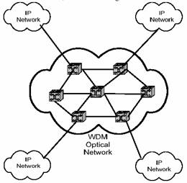

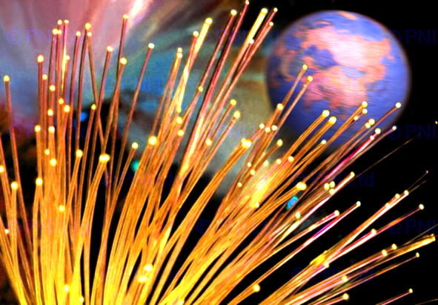


Effects of Packet Size and Wavelength Numbers on Delay and Link Utilization in Wavelength Routed Optical WDM Networks by using OWns
Optical WDM network technology has been identified as a suitable candidate for future WAN environments, due to its potential ability to meet rising demands of low latency and high bandwidth communication. Networking protocols and algorithms are being developed to meet the changing operational requirements in future OWANs (Optical Wide Area Networks). Simulation is used in the study and evaluation of new protocols, and is considered a critical component of protocol design. In this simulation study based on 100 nodes random topology by using OWns (Optical WDM network simulator), packet size 300 bytes with 16 wavelength numbers is presented as optimal for the Exponential session traffic as one of the design considerations of new protocol in Wavelength Routed Optical WDM networks.
Problem statement: New networking protocols are desired essentially in future optical WAN environments to meet increasing demands of communication with low latency and high bandwidth but a lack of uniformity in the choice of simulation platforms for optical WDM networks makes it difficult for researchers to exchange and compare obtained results under a common simulation environment. .
Methodology: 100 nodes random topology with each link having 16, 32, 48 and 64 wavelengths for two session traffic types Exponential and CBR is simulated by OWns while varying packet size ranging from 100 to 1000 bytes. Two major network performance measures are strictly observed: average packet delay and link utilization. Other simulation parameters are set as: connectivity probability 0.03, wavelength conversion factor 0.5, traffic pair density 0.6, load per traffic 0.3 Erlangs.
Conclusion:
For Exponential session traffic, at packet size 300 bytes the average packet delay gets its minimum value and efficient link utilization with 16 wavelength numbers as optimal.
Exponential session traffic performs well while comparing it with CBR session traffic.
More realistic traffic sources with packet switching such as self-similar traffic source will be integrated in OWns to achieve valuable simulation results.
Thesis statement: A simulation study based on 100 nodes random topology is conducted by using OWns (Optical WDM network simulator), to find effects of varying packet size with Exponential and CBR traffic sources on average packet delay and link utilization in optical WANs with WDM technology as one of the design considerations for new networking protocols.
Prepared by: Asima Nisar (52091) Supervised by: Dr. Irfan Hyder

